Slide 1




Responsive design with QML Proxy Layouts
Spyrosoft Group
© 2024
www.spyro-soft.com

Slide 2

Few words about me
Jan Kieś
Qt/QML developer for over five years
Worked together with Qt Group in Professional Services
I like to read a good criminal novel
Self-hosting & home automation enthusiast
https://www.linkedin.com/in/jan-kies/
Responsive design with Proxy Layouts
Shaping technology, together
www.spyro-soft.com

Slide 3
TOPIC
no
topic
1
2
3
4
5
What is the problem?
Say hello to LayoutItemProxy
Usecases
Qt/QML Case study
Q&A
Responsive design with Proxy Layouts
Shaping technology, together
www.spyro-soft.com

Slide 4
TOPIC
WHY?
Responsive design with Proxy Layouts
Shaping technology, together
www.spyro-soft.com

Slide 5






TOPIC
Problems we face
Supporting different screen ratios with single codebase
Simple usage of delivered controls -support for Qt Quick Layouts
Providing good UX for the users by reacting to events like window resize
Support for full internatilazion including RTL languages
Reduction of time to market for complex or multi-platform UI
CSS @media-like functionality needed
Responsive design with Proxy Layouts
Shaping technology, together
www.spyro-soft.com
Notes:
Ease of use – reduced need of knowledge transfers
Good UX
Reduced time to market by providing single

Slide 6
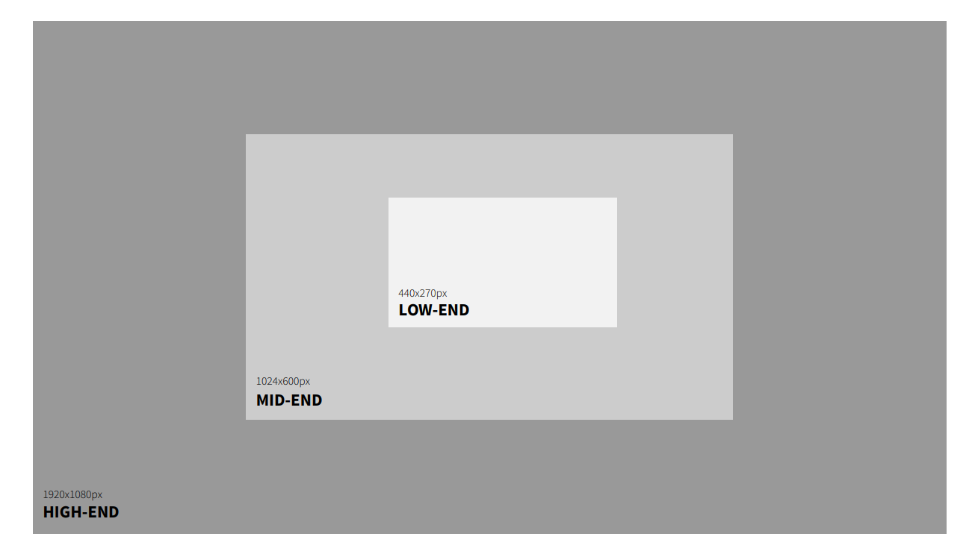
TOPIC
Problems we face
Responsive design with Proxy Layouts
Shaping technology, together
Source: User Interface Design for Smart Appliances Whitepaper by Qt Group
www.spyro-soft.com

Slide 7
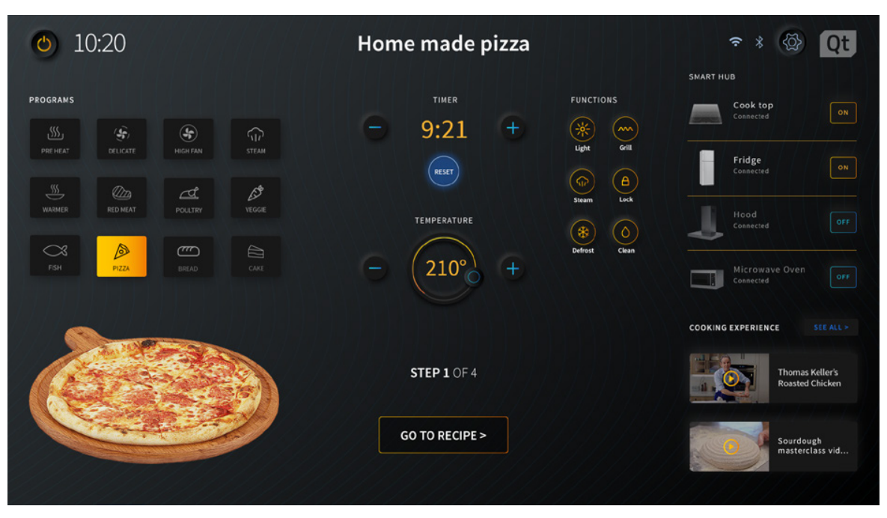
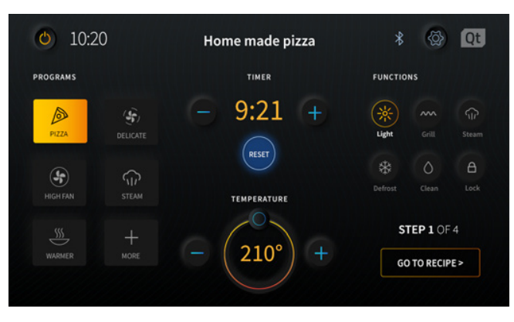
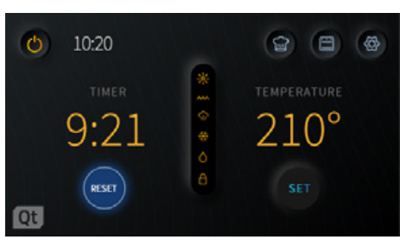
TOPIC
Problems we face
Responsive design with Proxy Layouts
Shaping technology, together
Source: User Interface Design for Smart Appliances Whitepaper by Qt Group
www.spyro-soft.com

Slide 8
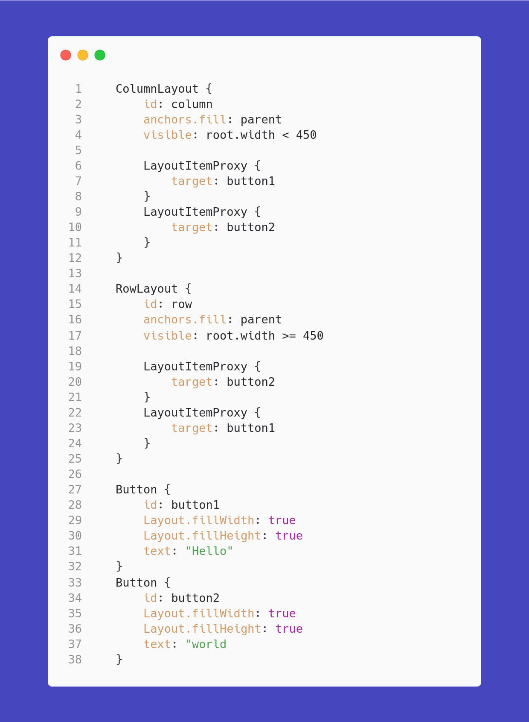

TOPIC
Hello LayoutItemProxy
Introduced in Qt 6.6
Passes one object to multiple layouts
Takes Item as a target
All Layout attached properties are forwarded
Responsive design with Proxy Layouts
Shaping technology, together
www.spyro-soft.com
Notes:
If you are familiar with Qt Quick Layouts the construction is really pleasant and straightforward.
The only difference from standard usage of the Layouts is that instead of instantiating the objects directly in the Layout we create them outside and pass the via LayoutItemProxy layout.
To select the active layout you simply need to decide which one is visible using binding or state.
You can also see that all of the Layout attached properties don't have to be copied but are automatically passed to the Layout.
The LayoutItemProxy will try to take control of the target item if it is visible. Taking control will position and resize the target item to match the position and size of the LayoutItemProxy. Further, the LayoutItemProxy will set itself as the parent of the target (to ensure event delivery and useful drawing order) and set the visibility to true.

Slide 9
TOPIC
Common usecases
Code of the examples available on the repository
Responsive design with Proxy Layouts
Shaping technology, together
www.spyro-soft.com

Slide 10
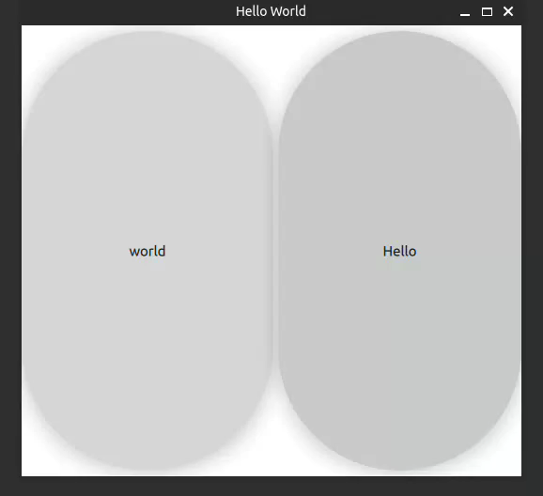
Let's try it out
Responsive design with Proxy Layouts
www.spyro-soft.com

Slide 11
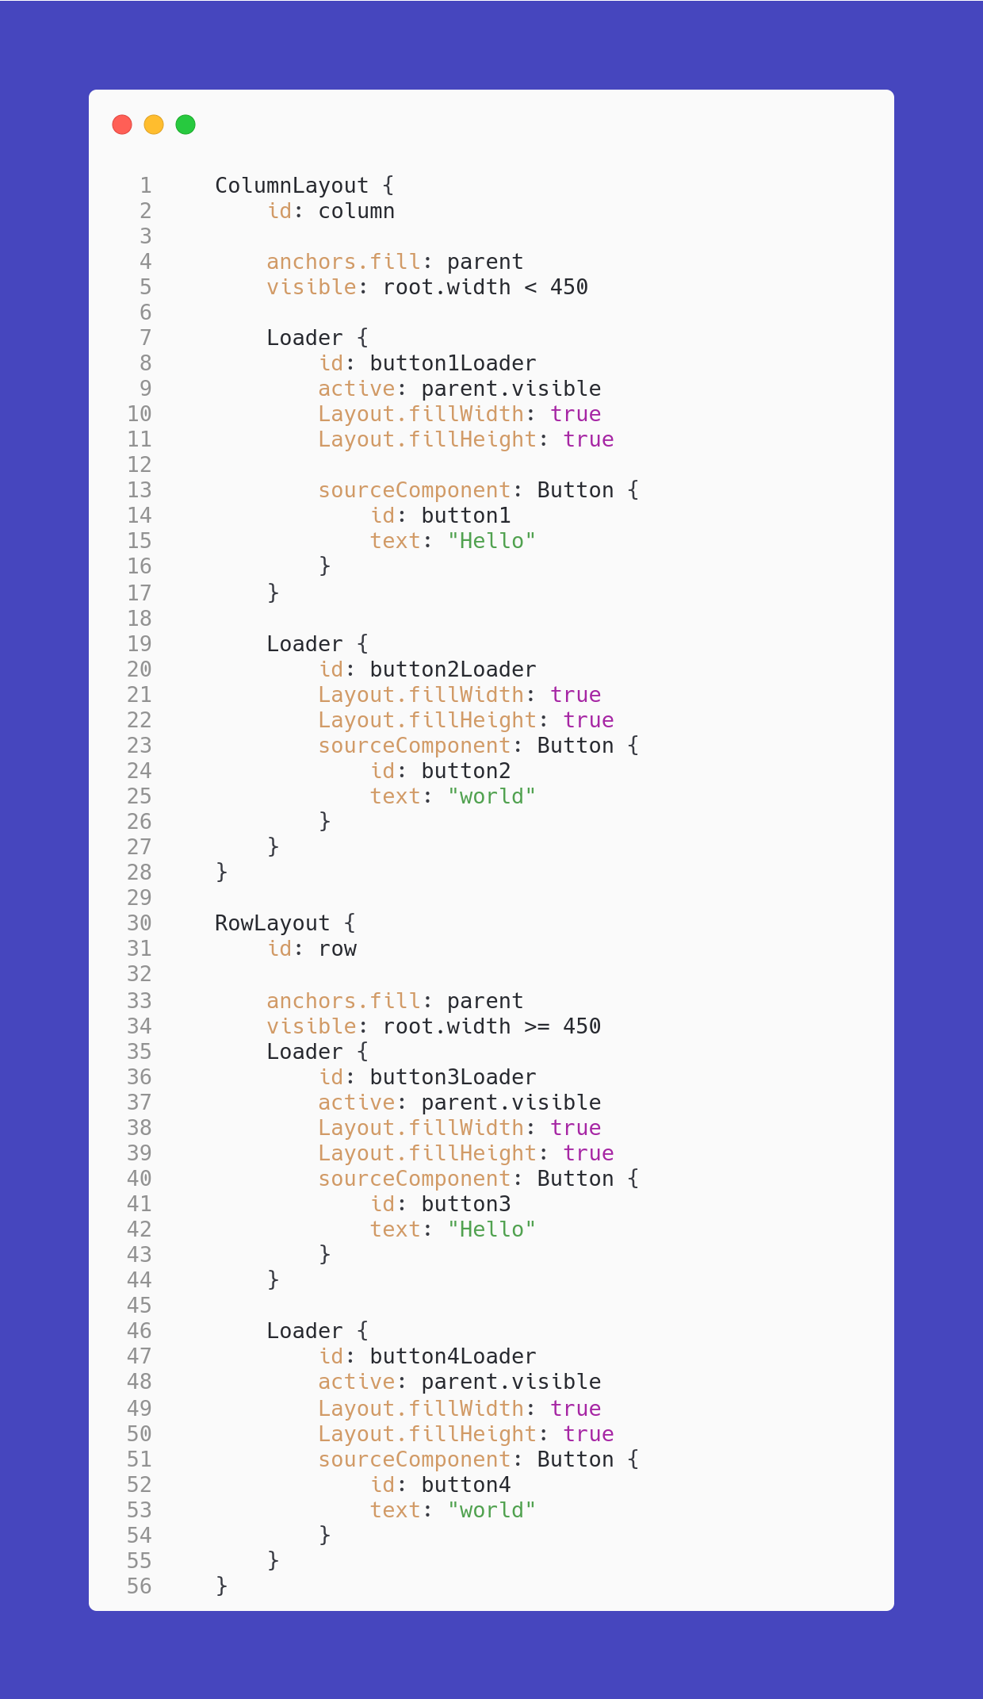
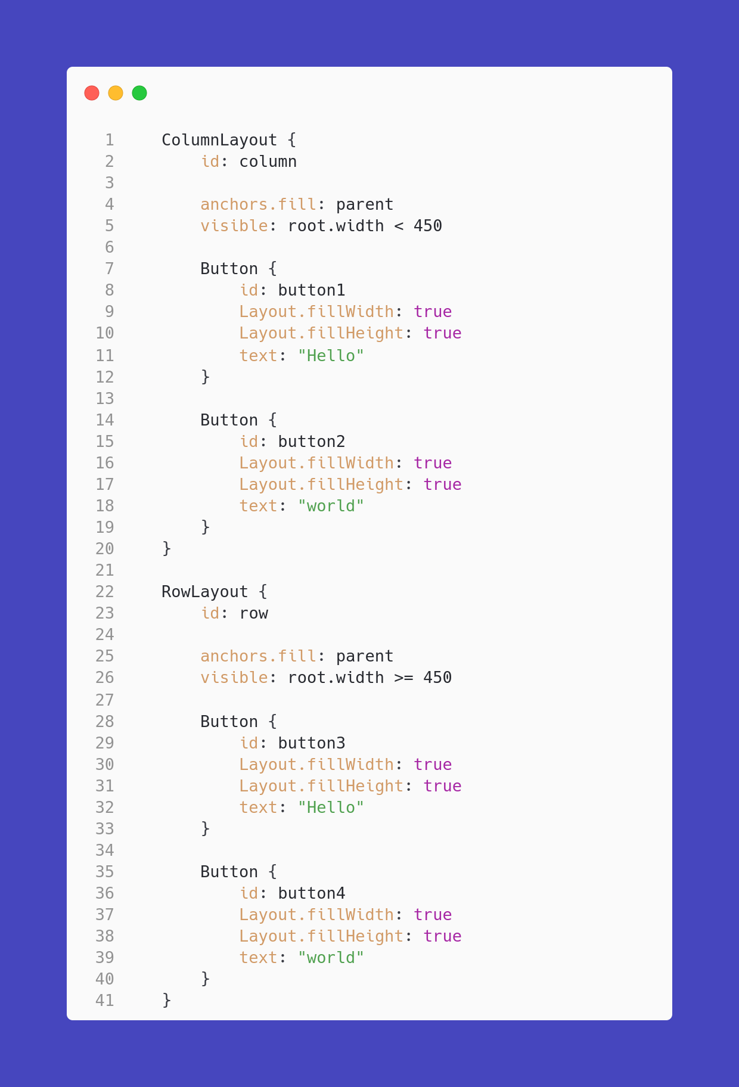
TOPIC
With vs without proxy
Responsive design with Proxy Layouts
www.spyro-soft.com

Slide 12
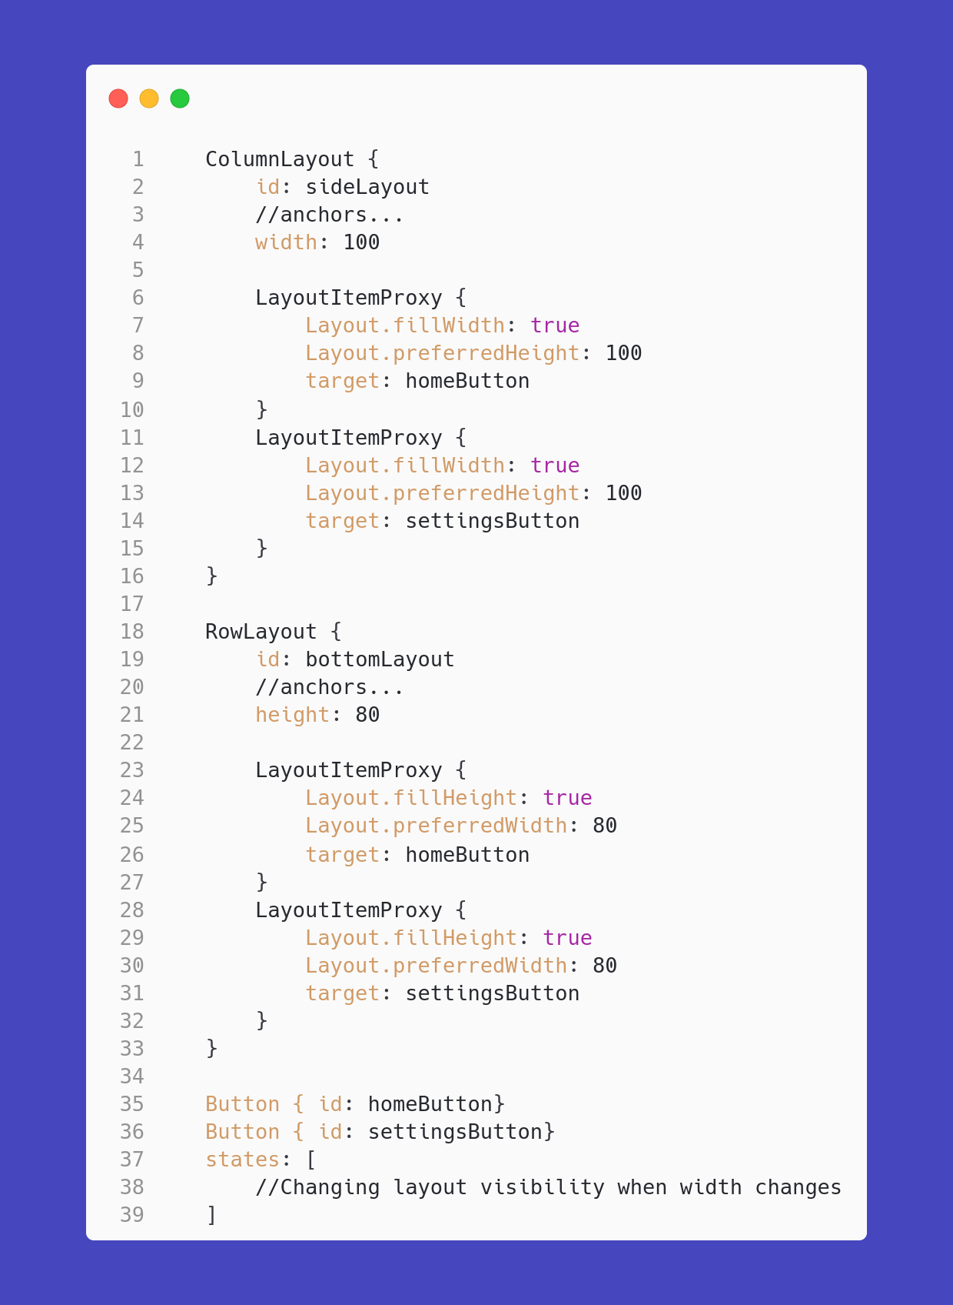
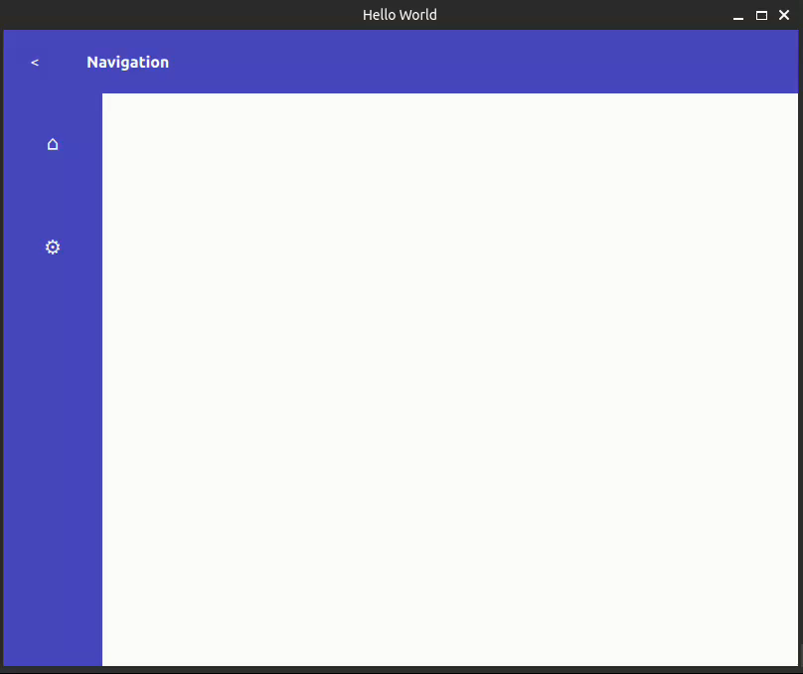
Properties in proxy
Responsive design with Proxy Layouts
www.spyro-soft.com

Slide 13
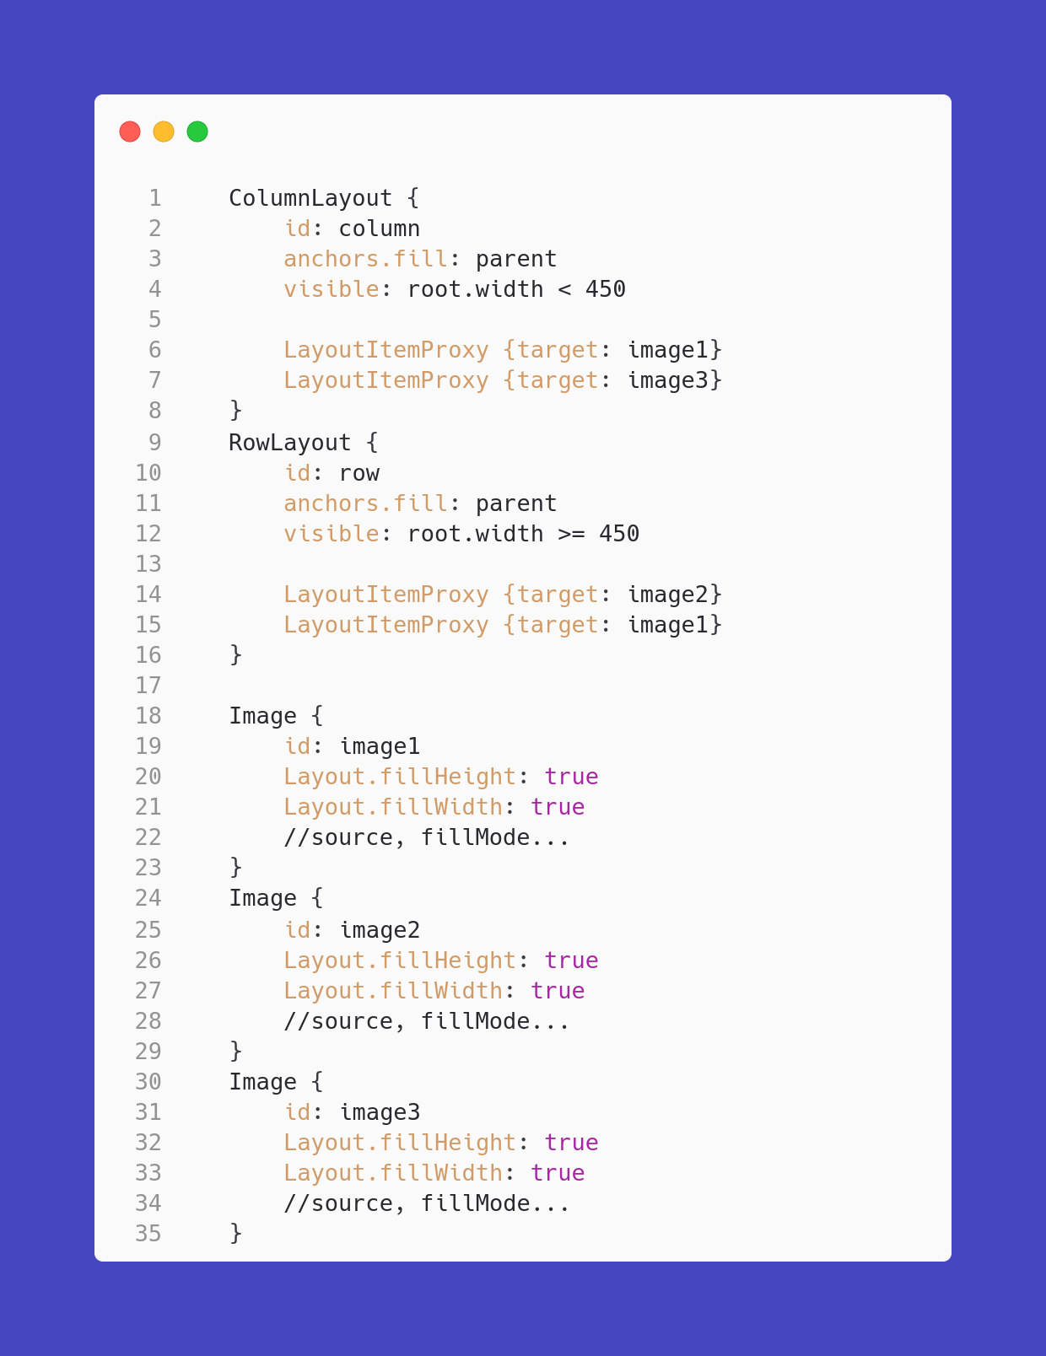
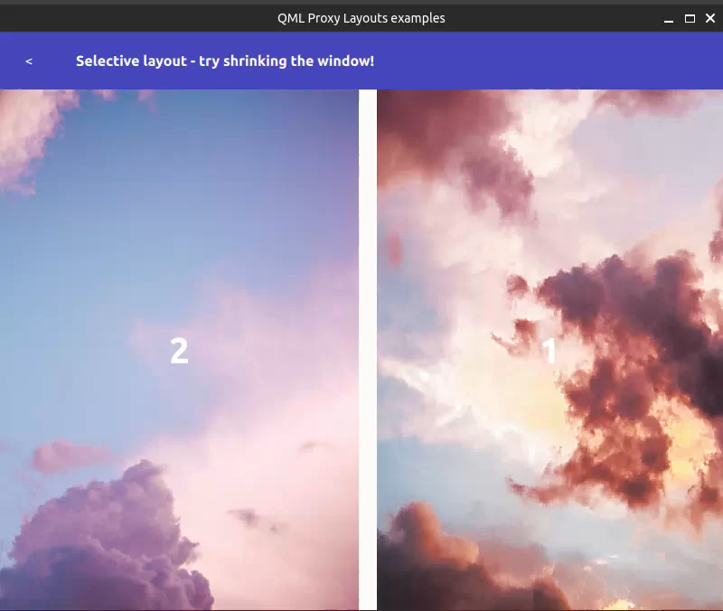
Hiding specific entries
Responsive design with Proxy Layouts
www.spyro-soft.com

Slide 14
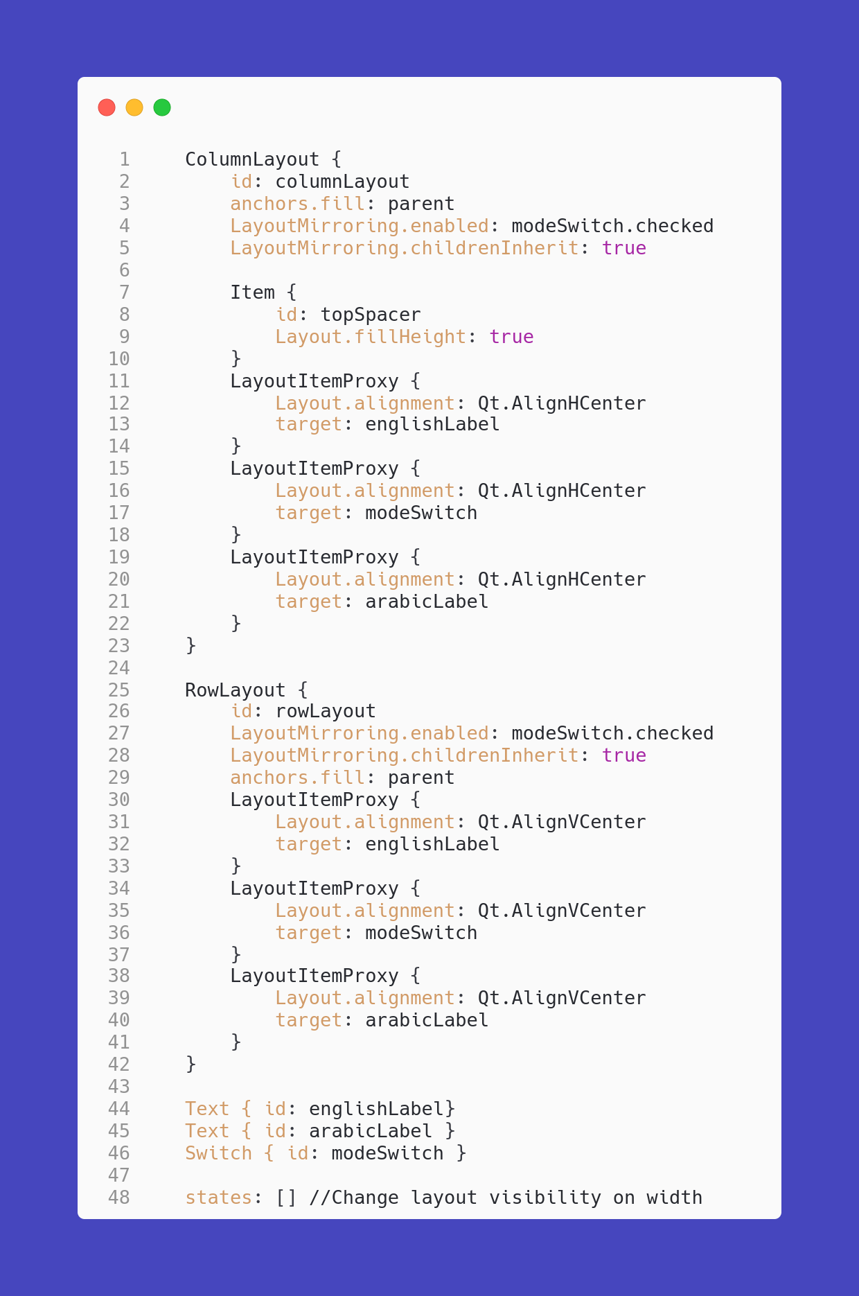
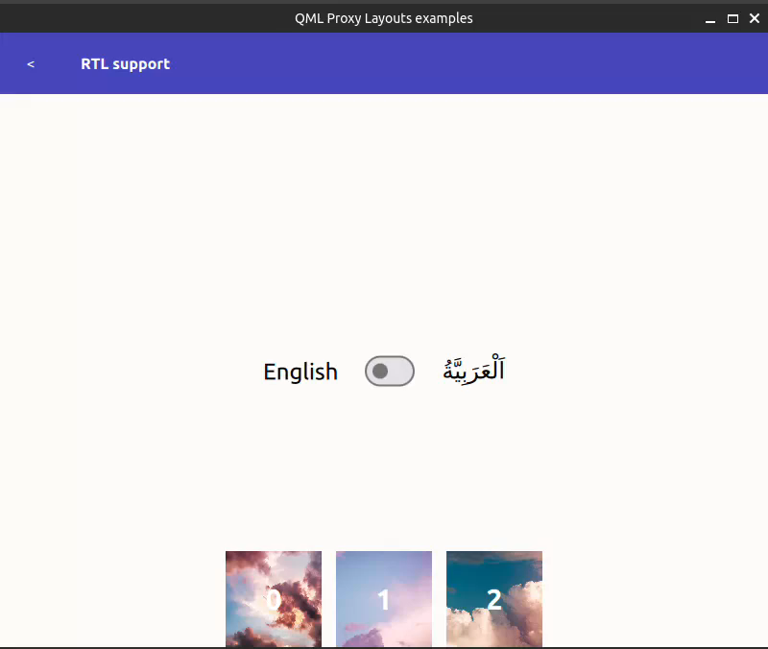
RTL languages support
RTL – Right to left language. For ex. Arabic and Hebrew
Responsive design with Proxy Layouts
www.spyro-soft.com

Slide 15
TOPIC
Watch out!
Responsive design with Proxy Layouts
Shaping technology, together
www.spyro-soft.com

Slide 16
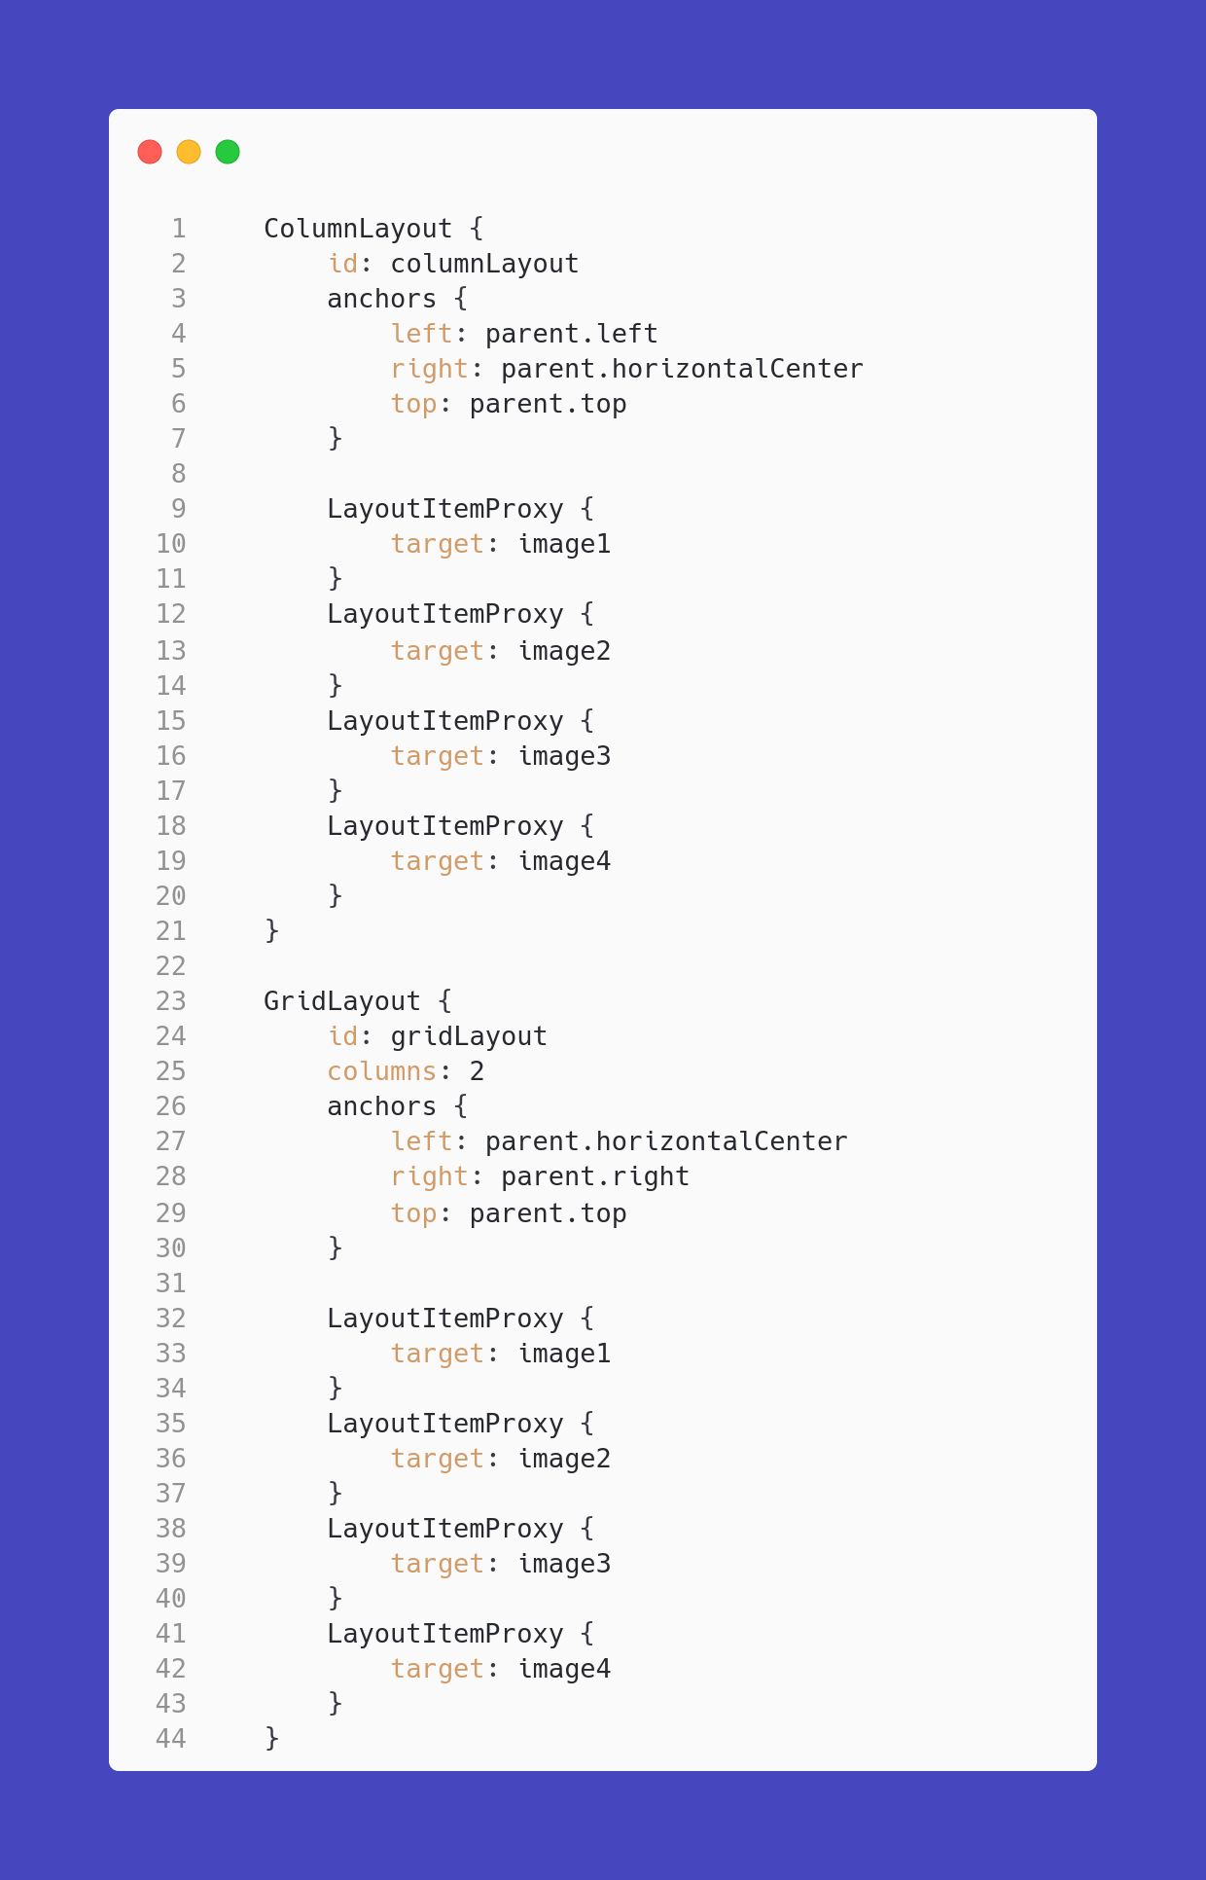
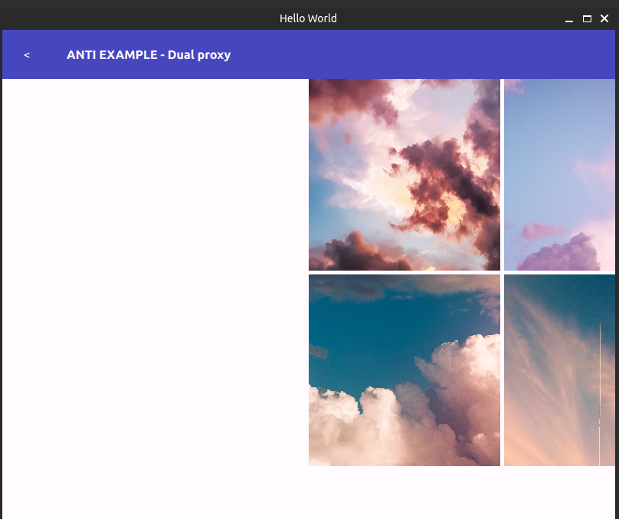
Would it work?
Responsive design with Proxy Layouts
www.spyro-soft.com
Notes:
Multiple LayoutItemProxies can target the same item, but only one LayoutItemProxy can control an item at a time. Therefore only one of the proxies targeting the same item should be visible at a time. If multiple proxies target the same item but visible is set to false for each proxy, the item will also be invisible.

Slide 17

TOPIC
Qt 6.7 - Potential regression
Planned change to the default sizing policy in Qt 6.7 layouts
Might introduce potential regression if you migrate project from older version of Qt
Discussion and status of the change tracked in Qt Jira
Source: https://bugreports.qt.io/browse/QTBUG-117597
Responsive design with Proxy Layouts
Shaping technology, together
www.spyro-soft.com
Notes:
Possibly default fill width and height

Slide 18
TOPIC
What Proxy Layouts are NOT about
One shown in multiple proxies at once
Item set as target displayed outside the proxy
Won't work LayoutItemProxy sets itself as parent. Last instantiated proxy item will takeover the item
If item is set as a target of LayoutItemProxy instances and all of the proxy items visibility will be set to true the target item will remain invisible
Pasing properties different than Layout
One proxy controlling multiple items
Proxy supports passing all Layout attached properties as well as implicit width and height. Other properties should be modified via states and other mechanisms
One LayoutItemProxy can only have one item set as a target at once
Responsive design with Proxy Layouts
Shaping technology, together
www.spyro-soft.com

Slide 19
TOPIC
Case study
Responsive design with Proxy Layouts
Shaping technology, together
www.spyro-soft.com

Slide 20
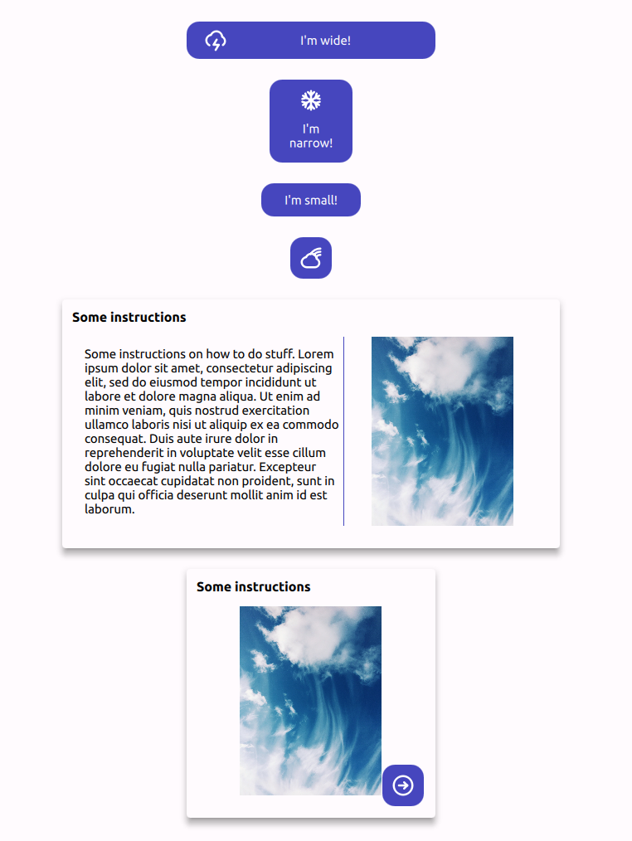
TOPIC
Common controls
UX want to enforce variants of controls in given sizing
Creating controls consumed by other devs
All of the variants for each control should be stored in one type
Devs shouldn't set the variants manually
Responsive design with Proxy Layouts
Shaping technology, together
www.spyro-soft.com
Notes:
If you are familiar with Qt Quick Layouts the construction is really pleasant and straightforward.
The only difference from standard usage of the Layouts is that instead of instantiating the objects directly in the Layout we create them outside and pass the via LayoutItemProxy layout.
To select the active layout you simply need to decide which one is visible using binding or state.
You can also see that all of the Layout attached properties don't have to be copied but are automatically passed to the Layout.
Sadly you cannot pass the non-Layout related properties to the target via the proxy item
The LayoutItemProxy will try to take control of the target item if it is visible. Taking control will position and resize the target item to match the position and size of the LayoutItemProxy. Further, the LayoutItemProxy will set itself as the parent of the target (to ensure event delivery and useful drawing order) and set the visibility to true.

Slide 21
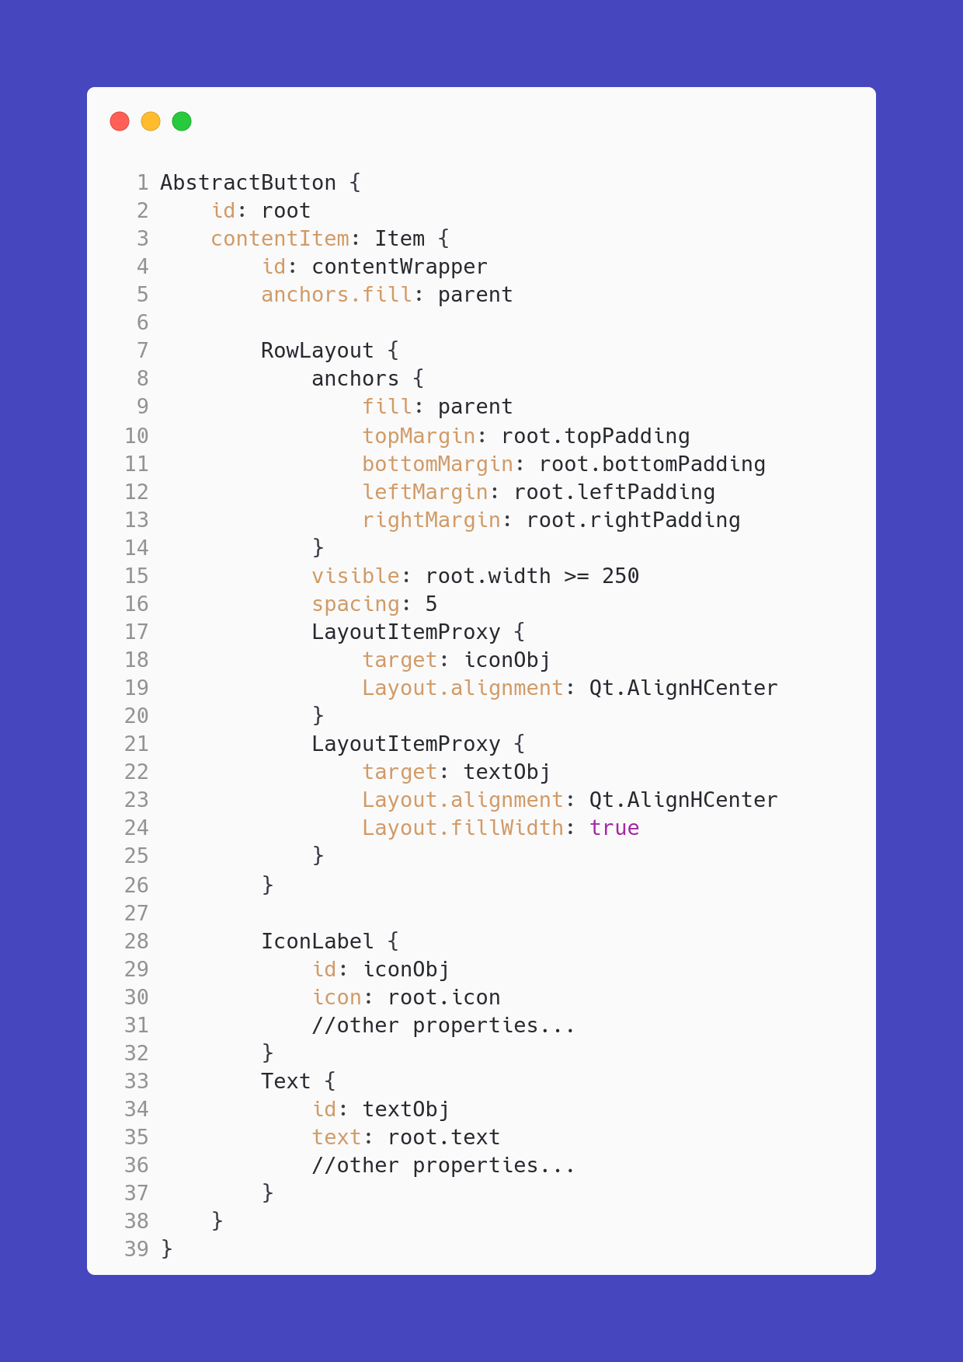
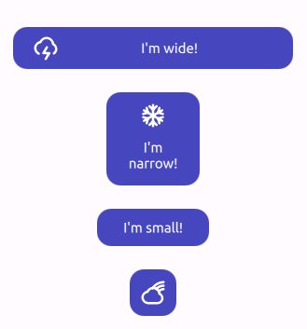
Button - Wide mode
Responsive design with Proxy Layouts
www.spyro-soft.com

Slide 22
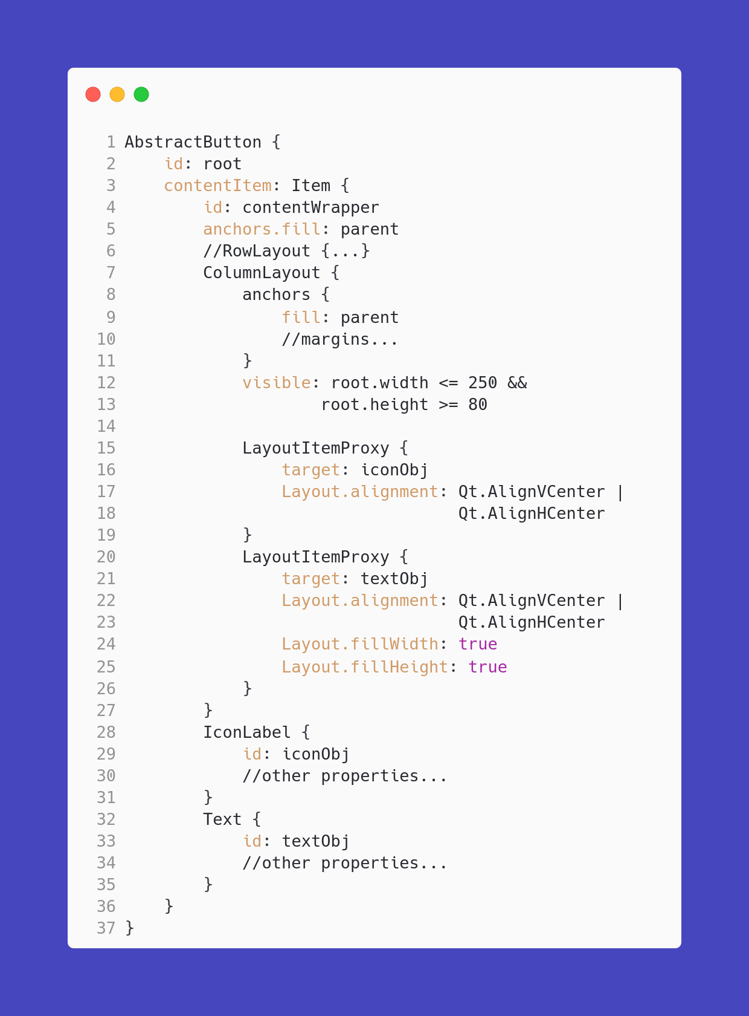
Button - Narrow mode
Responsive design with Proxy Layouts
www.spyro-soft.com

Slide 23
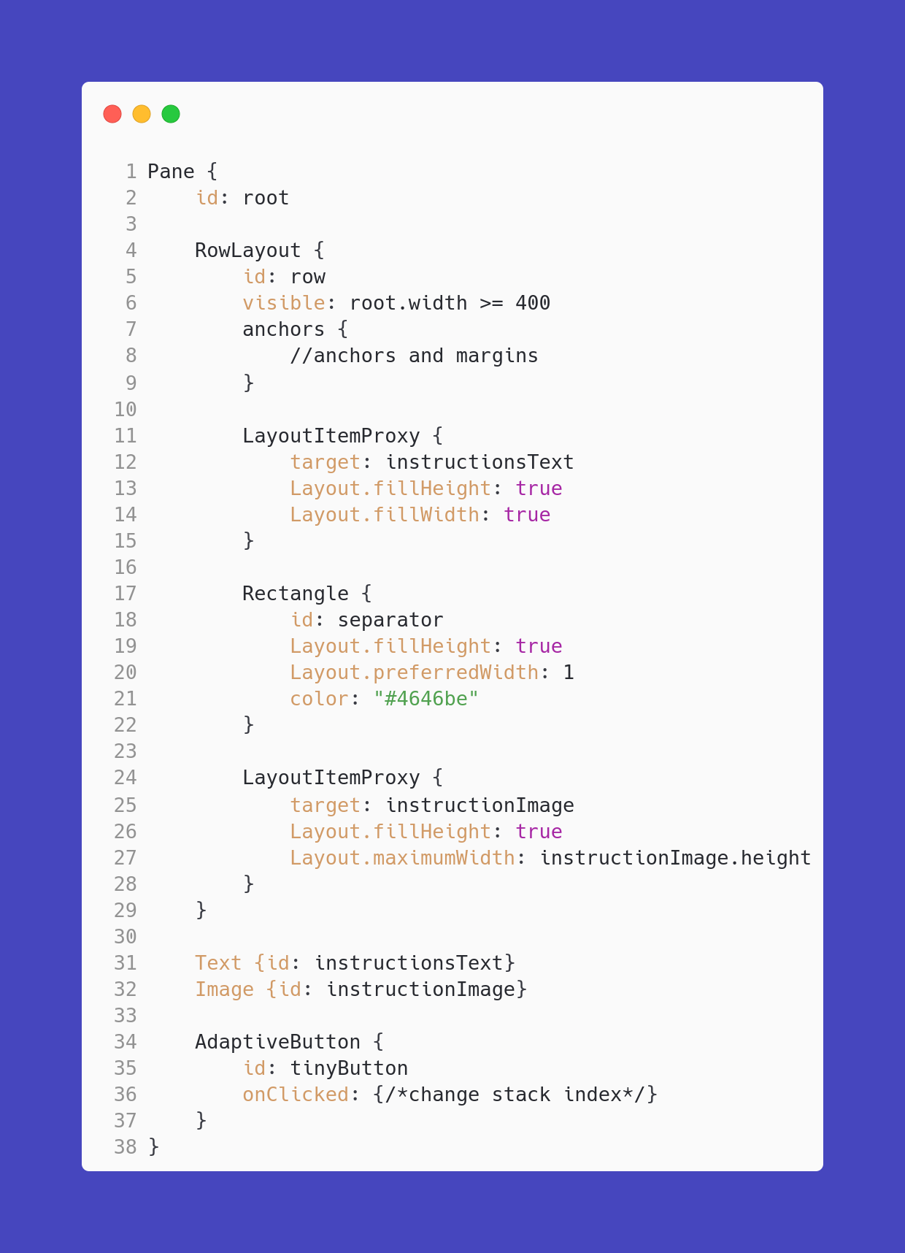
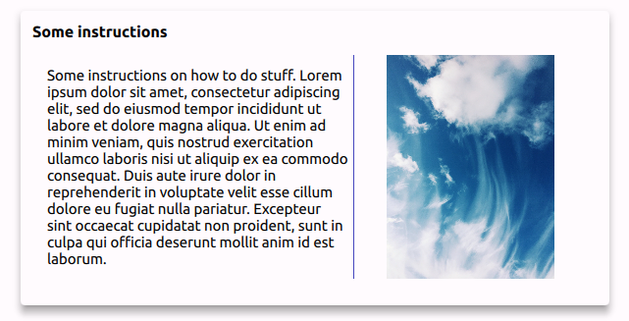
Card - Wide mode
Responsive design with Proxy Layouts
www.spyro-soft.com
Notes:
IMPORTANT – ProxyLayouts are mixed with "normal" items – Rectangle

Slide 24
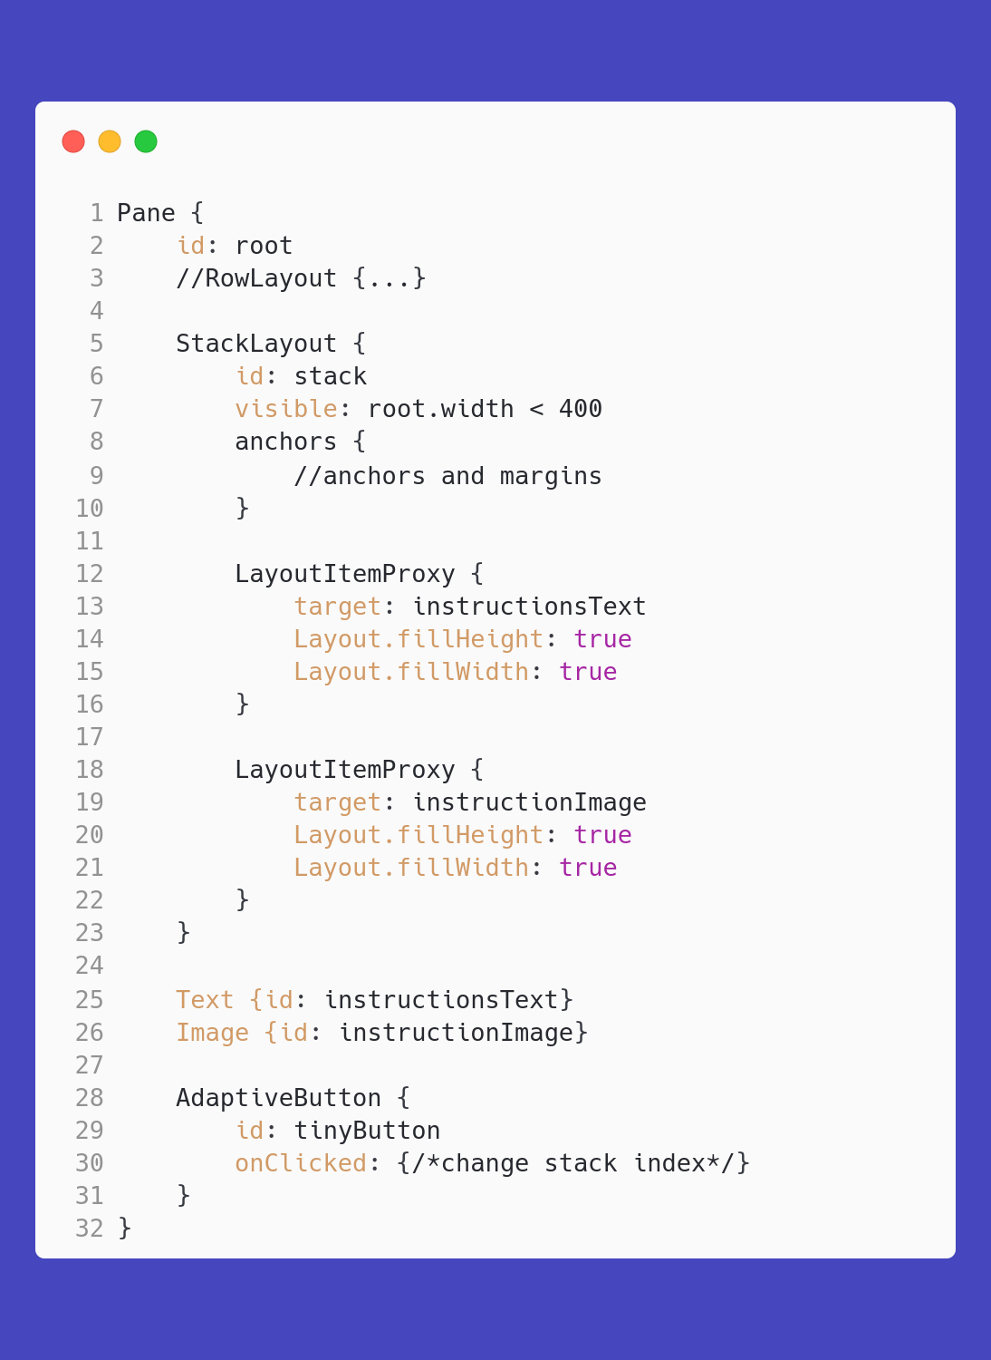
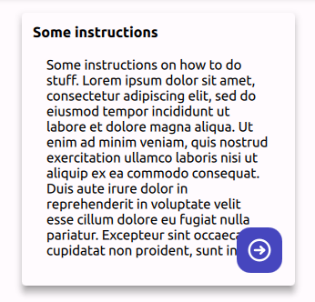
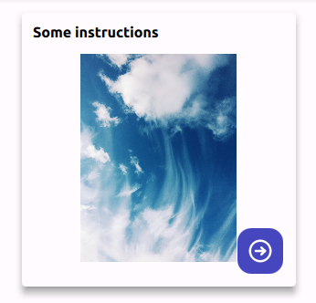
Card - Wide mode
Responsive design with Proxy Layouts
www.spyro-soft.com
Notes:
StackLayout is also supported – great option in case where you don't have enough space

Slide 25

Q&A
Responsive design with Proxy Layouts
Shaping technology, together
www.spyro-soft.com
Notes:
Jakie macie pytania I komentarze?
Dodać slajd z przedstawieniem – w jakich projektach pracowałem, co lubię etc.
Qt Service Partner Spyrosoft
Dodać nastawienie na Qt – to że będziemy opowiadać
Dodać wizualizację z urządzeniami z low/mid/premium - żeby od początku
Dać o tym czego nie robią na koniec
Let's continue here zamiast "The End"
Kod na Githuba Synergy
Dodać kod QR z linkiem do Repo
Wspomnieć że będą przykłady na repo
Zrobić przykład implementacji bez wykorzystania ItemProxy I z
Dać uzasadnienia biznesowe do problems we solve
Dawać wyjaśnienia typu co to RTL
Dodać do obrazków numerki żeby łatwo załapać
Jakie macie pytania lub komentarze zamiast "czy są jakieś pytania"
Porawić wcięcie w ColumnLayout
Dodać prezkę do Githuba

Slide 26





Thank you!
Let's continue here
https://github.com/SpyroSoft-Synergy/QML-Proxy-Layout-examples
jai@spyro-soft.com
www.spyro-soft.com
https://www.linkedin.com/in/jan-kies/
Shaping technology, together
www.spyro-soft.com

